Slide 1
Welcome to
I’m so glad to be your child’s teacher! We’re going to have a great year. ☺

Slide 2
Classroom Procedures and Routines
Let’s learn about some of the routines and procedures in our class for the coming term and year ahead.
Please ask any questions as we work through the PowerPoint.

Slide 3
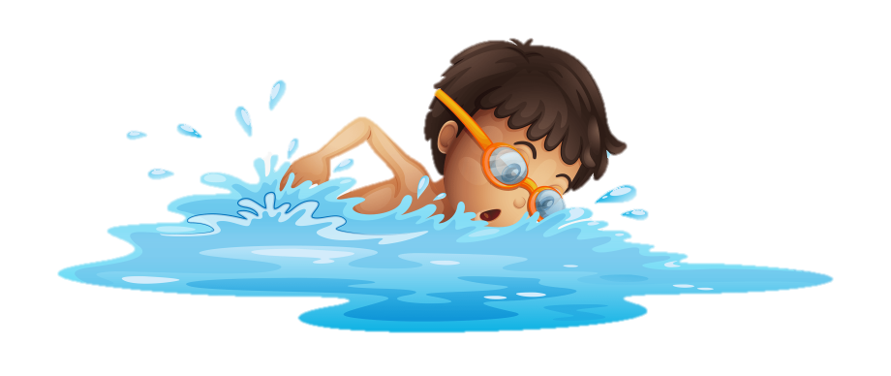
General Whole School Reminders
PE Kit: We request that the PE kit should be in school all week, with it brought in on Monday and not going home until Friday. This is so there is flexibility in the day for PE and allows for any other unexpected physical activity.
Swimming day: Monday while the weather stays nice!
Uniform and long hair
Homework

Slide 4
Homework
This year we would like to focus on the basics of reading, spelling and times tables.
These will be put in new home school books weekly on a Friday.
Spelling tests will be on Wednesday mornings.
Half termly times table tests.
Each child has a home school diary which needs to be in school each day.

Slide 5
Home school books
Checked every morning to ensure daily reading is taking place.
At the bottom right hand side of each day please put your initials in the box to show you have read with your child each day.
Miss Stanley will highlight green when seen!
Reading books will be changed daily in school.
Comments or messages welcome but not essential.

Slide 6
READING
Reading is fundamental to function in today’s society.
Reading skills are vital to finding a good job.
Reading develops the mind!
It is how we discover new things.
Reading develops the imagination.

Slide 7
READING
6. Reading develops the creative side of people.
7. Reading develops a good self image.
8. Reading skills, especially in a phonics program, improve spelling.
9. Reading is fun!

Slide 8
Title

Slide 9
Behaviour
We our proud of behaviour at Isleham Primary School and want it to remain excellent. To maintain this excellence we will offer:
Dojo points for teamwork, working hard, great effort, politeness, helping others, homework and persistence. (and other outstanding acts)
With 20 points there will be 20 minutes of golden time, each week.
The children in each class choose the golden time activities
If rules are not followed dojos can be taken away. Eg. For no effort, not listening, rudeness, refusal, talking over an adult or for a red card.
If a child has not reached the 20 dojos over the week then they will sit out for the minutes they have missing. (eg. 19 dojos gained will result in 1 minute away from golden time)
With 30+ dojos, the children are able to add a house token to their team. This builds to a treat for the winning house each term. Eg. Film, play at the park.
Opportunities for activity at lunch
playtime, eg craft, sport, games etc.

Slide 10
Thank you for coming!
If there are any questions or comments,
then please share them now.
Thank you.

